Slide 1
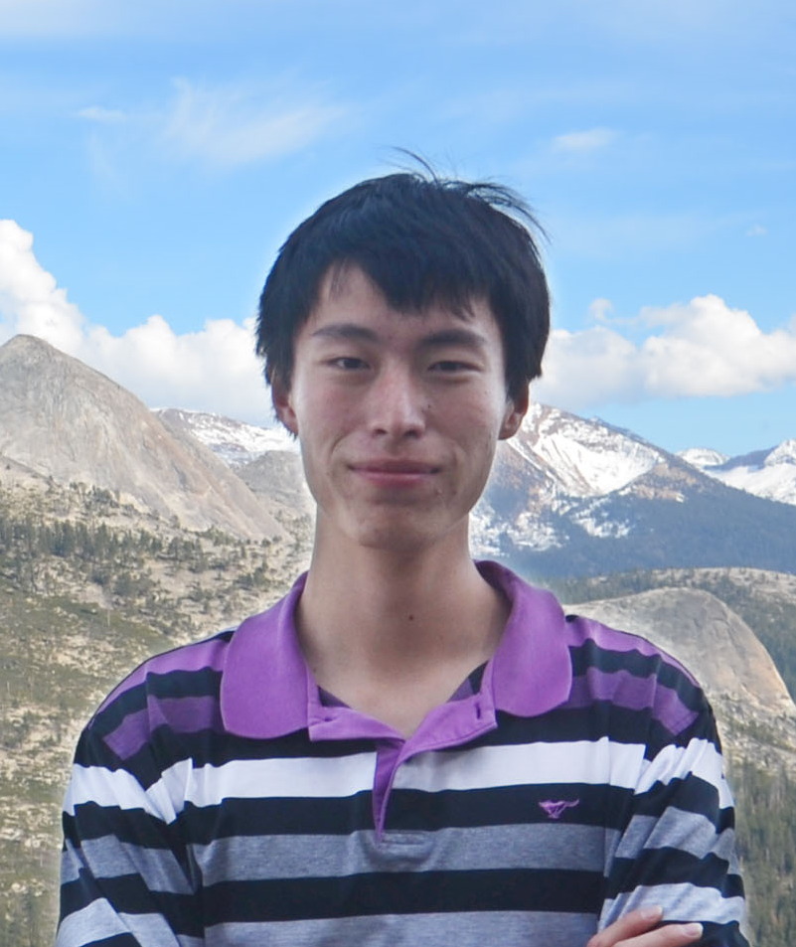
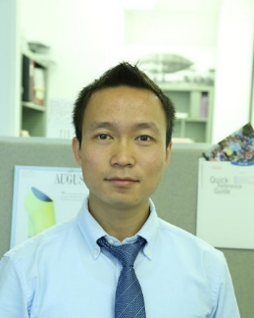
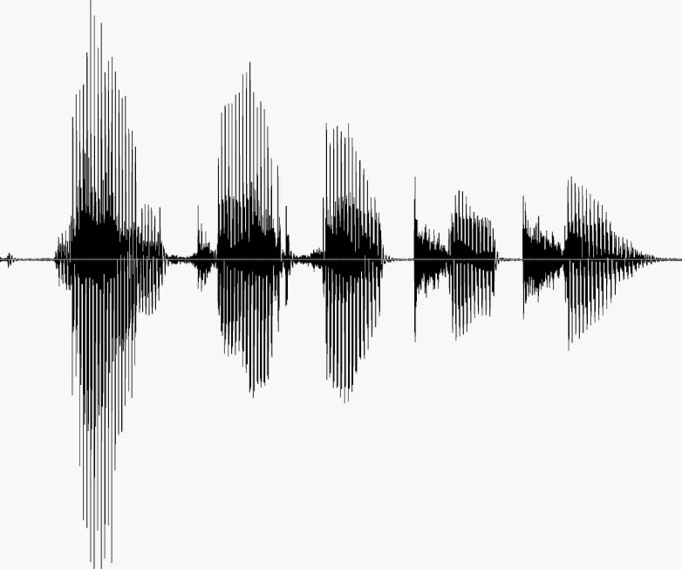
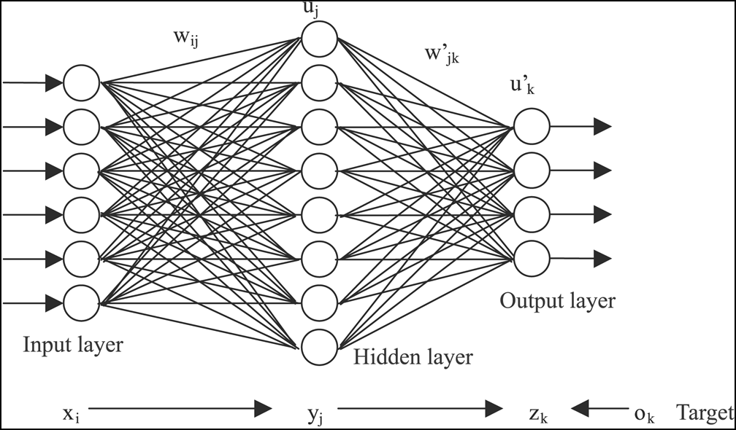

Hang Su & Haoyu Chen
Parallelizing Neural Network Training using
Model Averaging and Butterfly Mixing
Parallelization of DNN training
Model averaging strategy
Butterfly-mixing
MPI + CUDA implementation
Continuous time Automatic Speech Recognition (ASR)
Achieved reasonable speed up while keeping recognition performance

